Slide 1
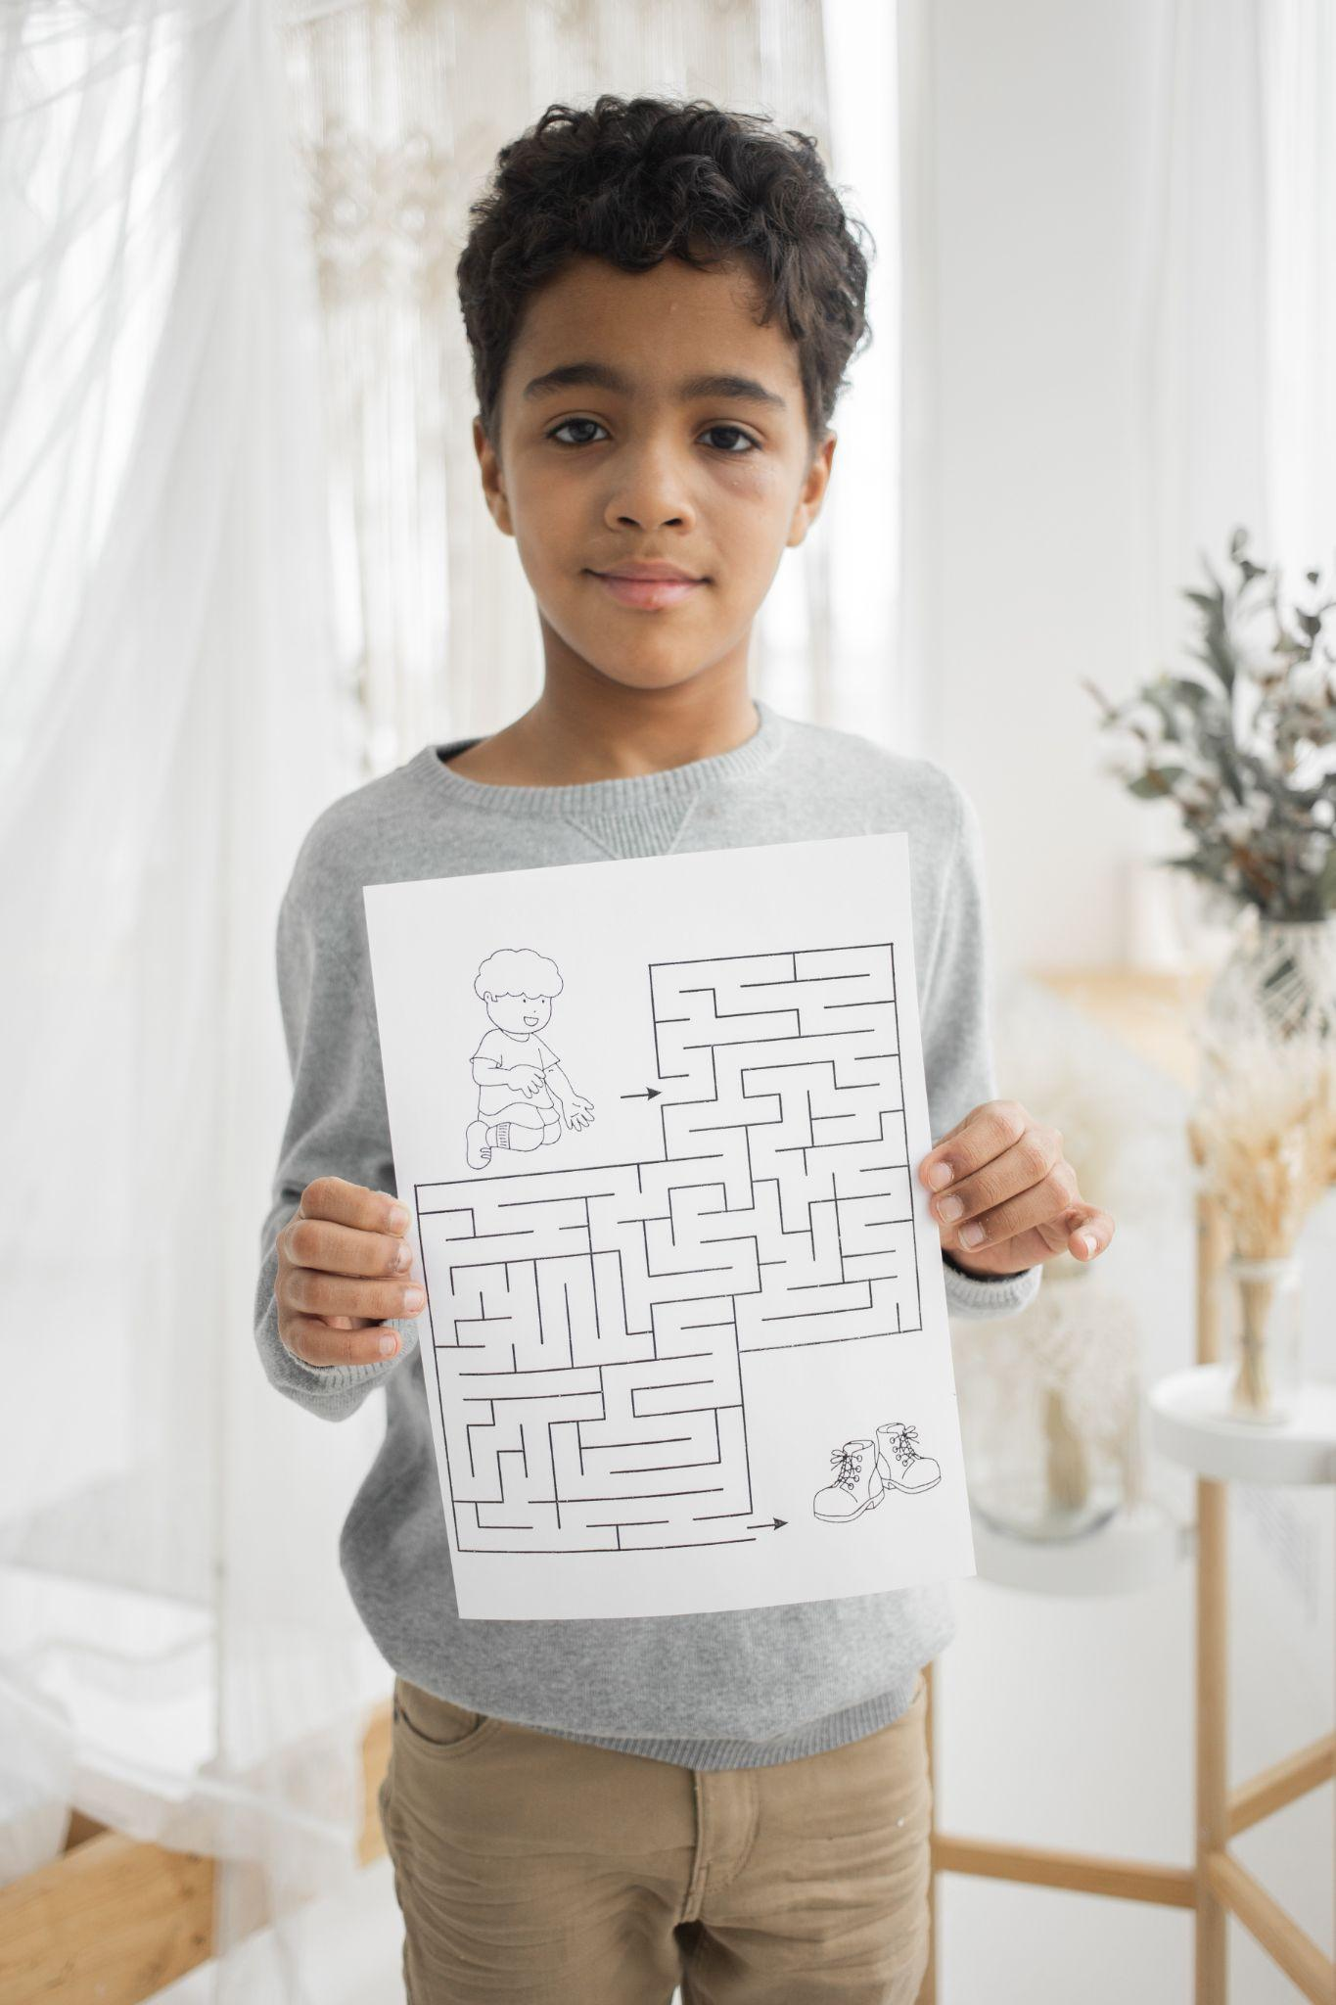
Elabyrinth Game Application
Group 9

Slide 2

CONTENTS COVERED
Introduction
Data flow diagrams
Functions
Screenshots
Non functional requirements
Applications
Challenges Faced
Conclusion
Image by storyset

Slide 3
What is the actual game and its purpose ?
A Labyrinth is a tree-based maze in the Royal House of England where the royals often enjoyed themselves with their servants who would get in and find their way out of a labyrinth maze.
The purpose of this project is to implement a maze game that involves multiple mazes to play from. The game involves varied walls that restrict player movement and bombs that kills the player.
The main purpose of such puzzles is not only entertainment but also teaching by increasing our knowledge and stimulating curiosity.

Slide 4
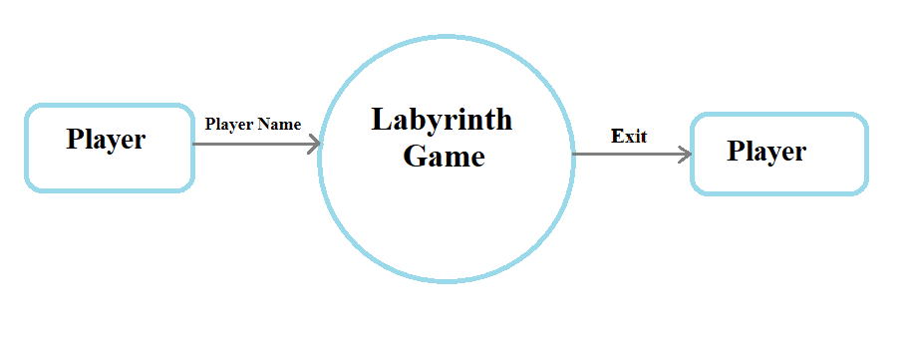
Data Flow Diagram 0

Slide 5
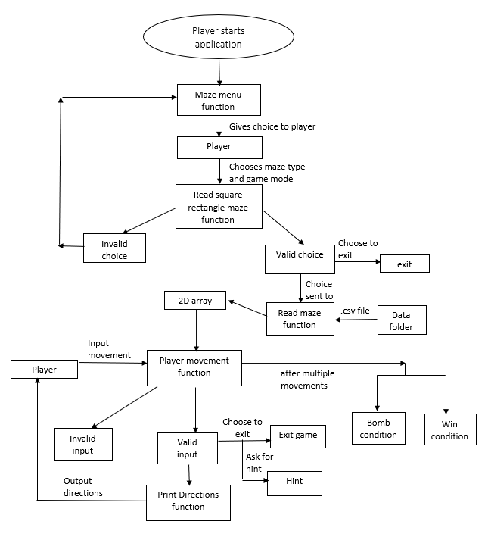
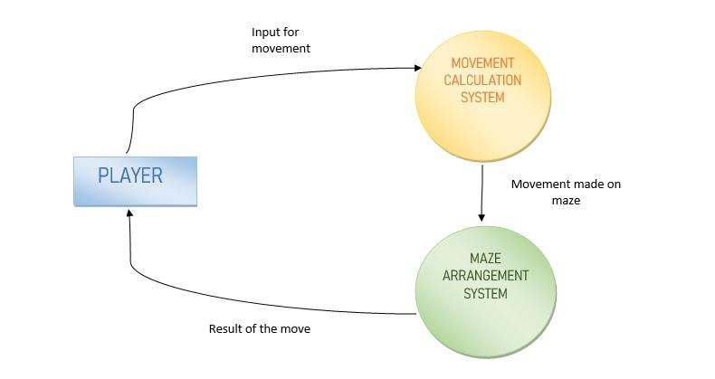
Data Flow Diagram 1

Slide 6
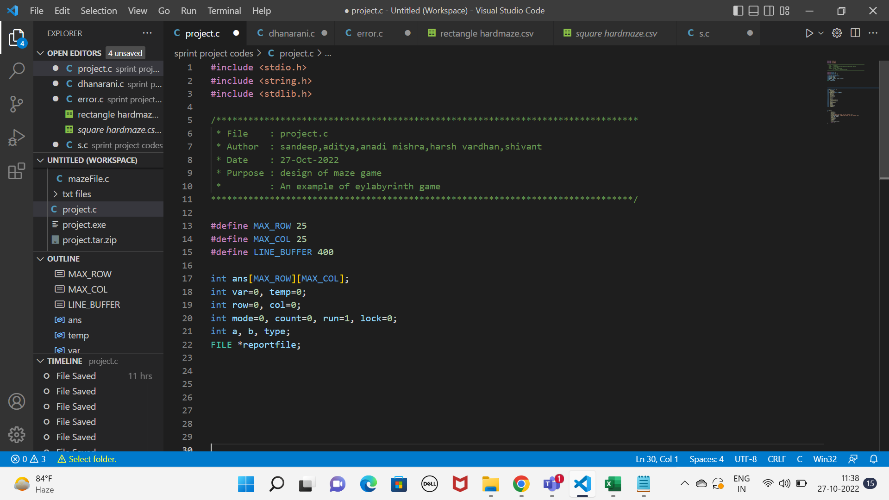
Header files ,Macros and Global declaration of Variables.
The header files contained the set of predefined standard library functions used for the game.
The C preprocessing directive “#include”. All the header file have a '. h' an extension.
The macros used here to define the constant value and variables with its value in the entire program that will be replaced by this macro name.
There are some variables to be changed everywhere in program. Hence global declaration of variables is required

Slide 7
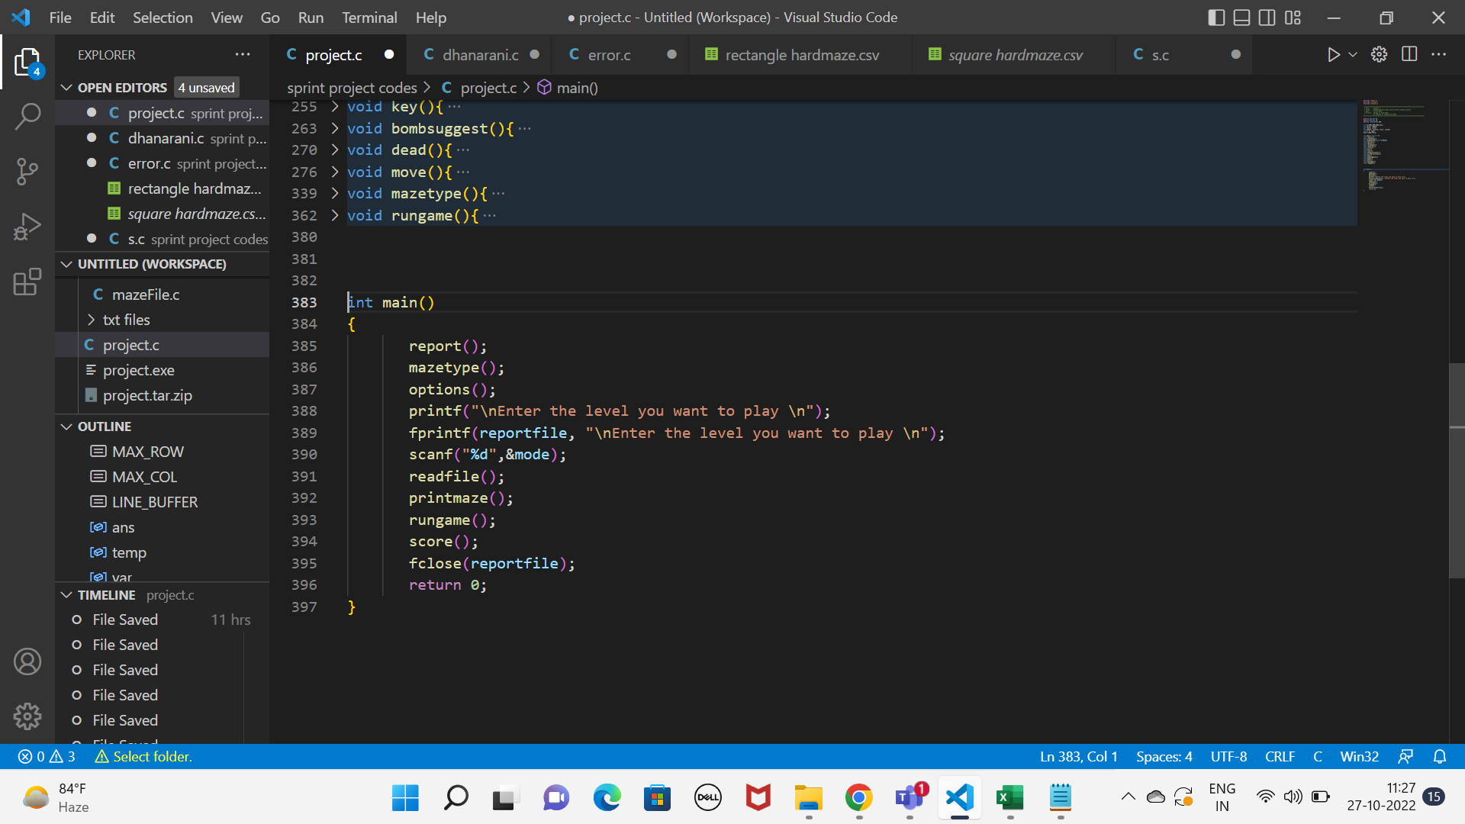
main()
The main function serves as the starting point for program execution.
It controls program execution by directing the calls to other functions in the program.
We use this function to control the overall files in the game.

Slide 8
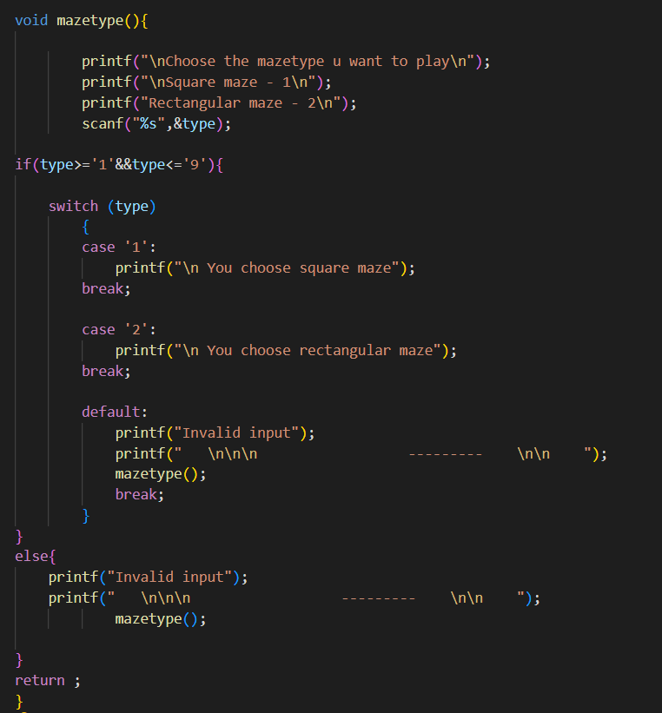
mazetype()
It asks the dimension of maze the user wants to play and shows the options the user can select.
This function uses a switch case to print the maze the user choose.
If the user choose a other input . It again asks the user to choose till he choose a correct input.

Slide 9
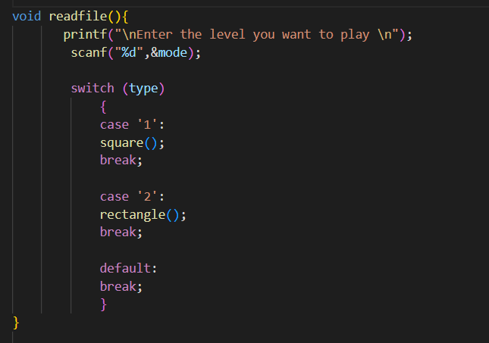
readFile()
In readFile function switch case is used, if case 1 then square mazes are loaded and if case 2 then rectangular mazes are loaded.
We set break as a default, if player doesn’t enters a value.

Slide 10
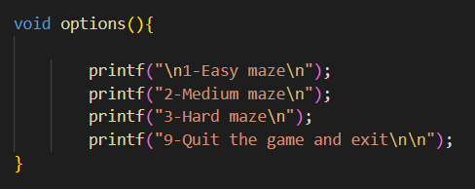
options()
In options function, player is prompted to select the level of maze he wants to play.
Like :
Press 1 for EASY MAZE.
Press 2 for MEDIUM MAZE.
Press 3 for HARD MAZE.
Press 9 for QUIT AND EXIT THE GAME.

Slide 11
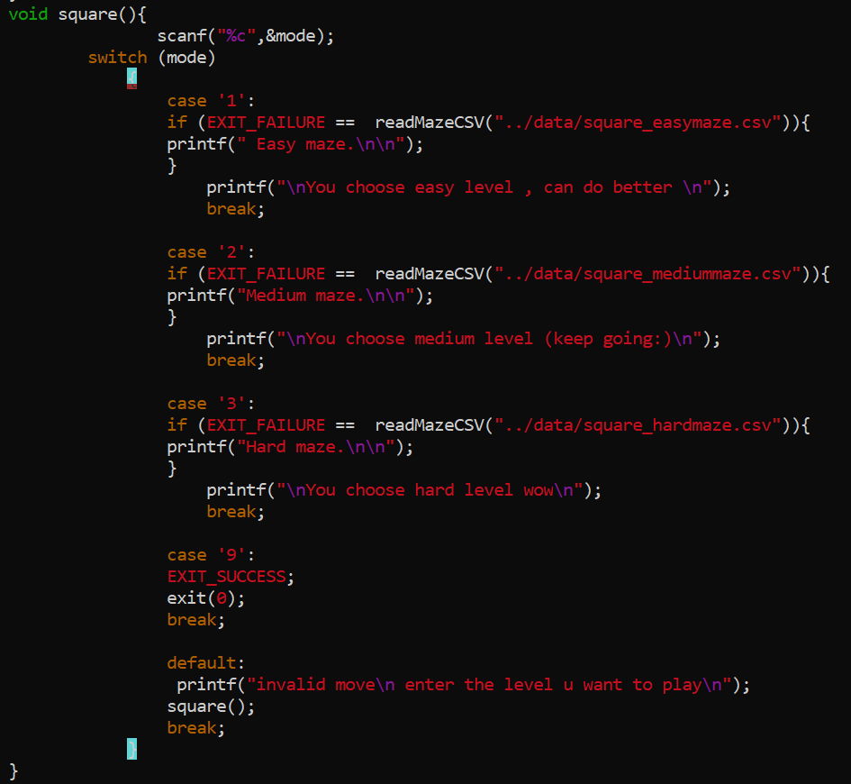
square()
Square function calls another function that is responsible for reading CSV maze files.
Square function is used for printing the square maze.
If player wants to play easy maze then it print easy square maze.
If player wants to play medium maze then it print medium square maze.
If player wants to play hard maze then it print hard square maze.

Slide 12
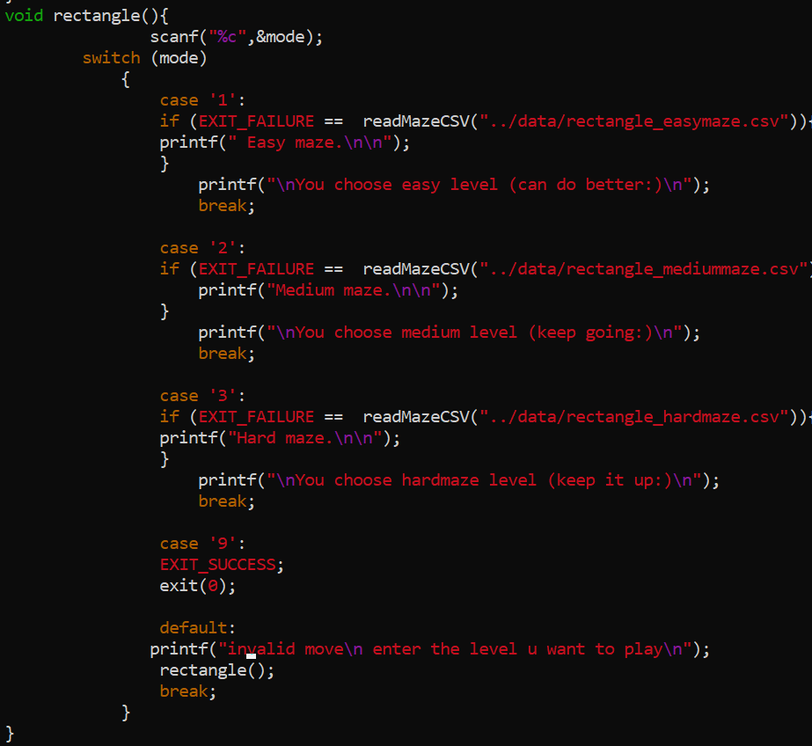
rectangle()
Rectangle function is used for printing the Rectangle maze.
If player wants to play easy maze then it print easy Rectangle maze.
If player wants to play medium maze then it print medium Rectangle maze.
If player wants to play hard maze then it print hard Rectangle maze.

Slide 13
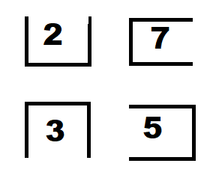
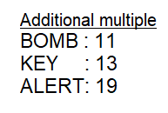

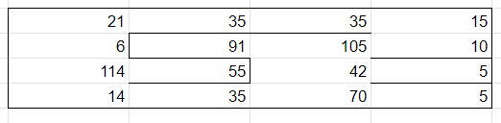
Maze creation logic
4*4 maze

Slide 14
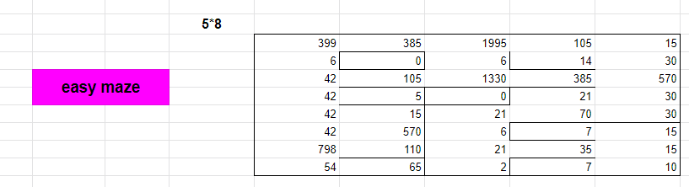
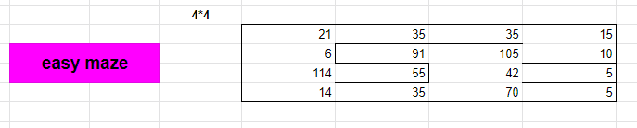
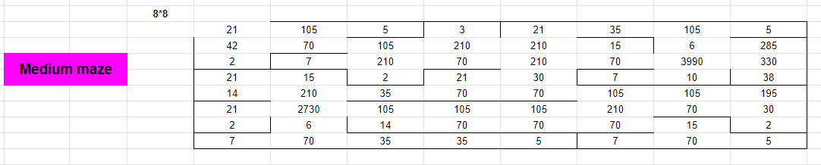
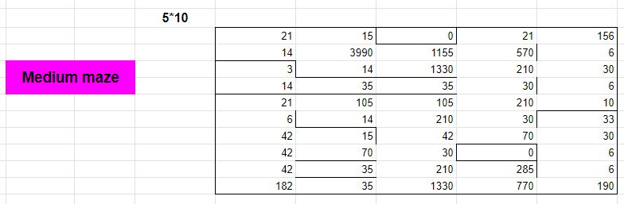

Slide 15
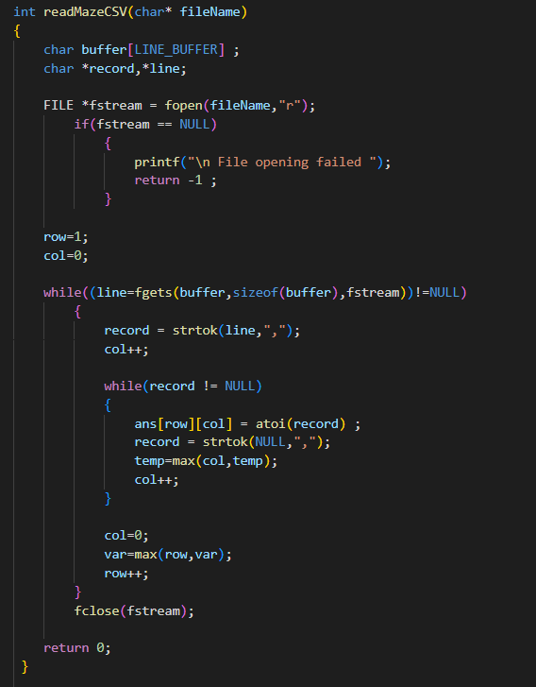
readMazeCSV(char* fileName)
This function is the core part of our game it is responsible for reading all the different maze file and maintaining the records of it.
For reading the file we use the File handling and also using the string function ‘strtok( )’ for retrieving the data from the files.

Slide 16
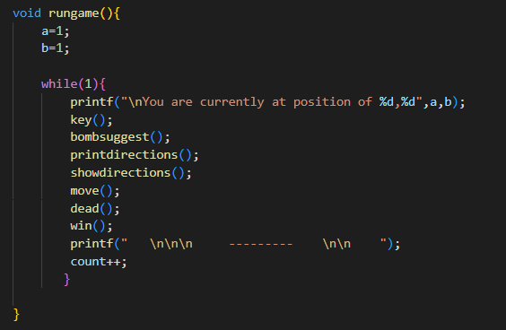
rungame()
The function rungame() is responsible for
running the program and it also contain
other functions like : key(), bombsuggets(),
showdirection() etc that help to run our
program smoothly.

Slide 17
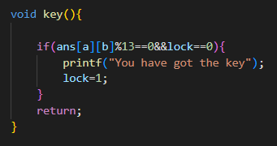
key()
The key() function is basic and small function that describes that player have got the keys or not from the mazes.
If the player does not have the key and it reaches
the end than player not win the game instead he
got message “You not get the keys”.
Player cannot win the game without having all the keys.

Slide 18
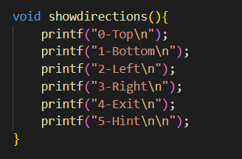
showdirections()
This function is responsible to guide the player how to navigate in our Elabyrinth
This function shows the main set of keys that are used to
Navigate inside the maze
Ask the game for hints
Exit the game

Slide 19
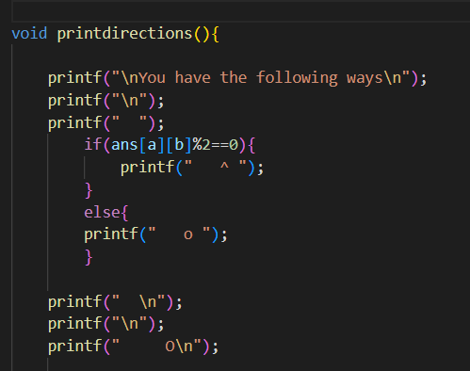
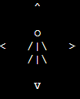
printdirections()
Print direction is the most important function from the players perspective because this is the function which shows the player which directions he can possibly make a move and which directions he cannot move.

Slide 20
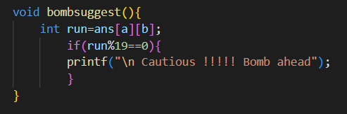
bombsuggest()
Bomb suggest function is a helpful function to the player. This function warns the player whenever the player is nearby a bomb to make the player choose his/her next move with caution

Slide 21
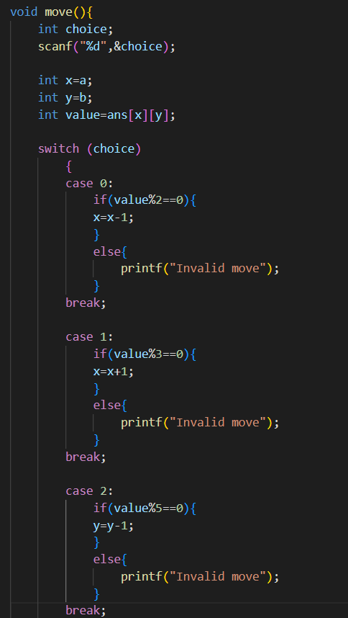
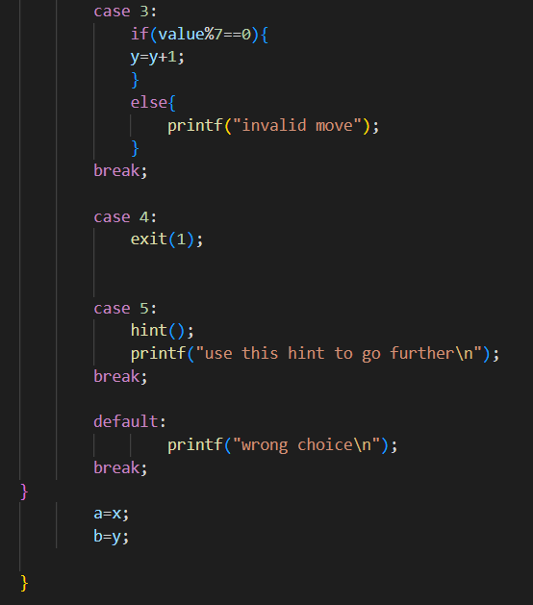
move()
This function is responsible for movement, we use switch case along with if statements to control the movement of player, the if walls are present on any sides we restrict the movement in that directions.

Slide 22
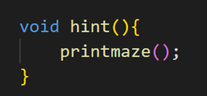
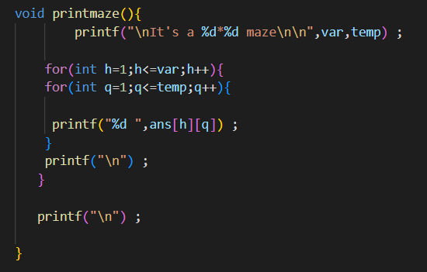
hint() && printmaze()
This function invokes another function as hint for the user. If the user is stuck at any point and want to see the maze then he can use this hint function.
This function prints out the maze for the player.

Slide 23
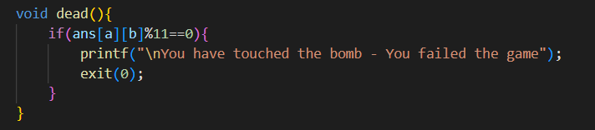
dead()
This function is called when a player steps into the block with bomb. The game exists as soon as this function is called.

Slide 24
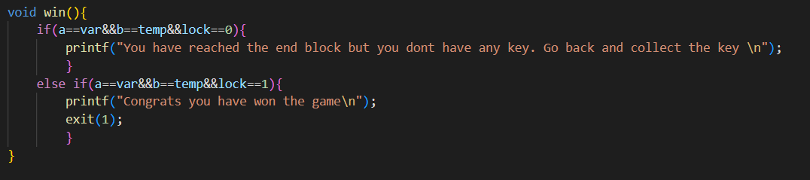
win()
Once you reach the last block the game finishes and so the player wins the challenge and the game exits.

Slide 25
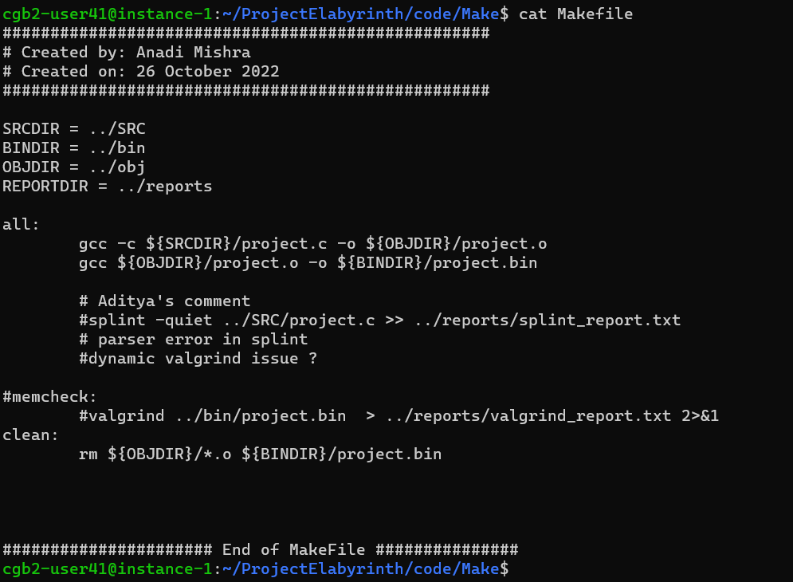
Non Functional Requirements
Makefile - It is a way of automating software building procedure and other complex tasks with dependencies. Makefile contains: dependency rules, macros and suffix(or implicit) rules.

Slide 26
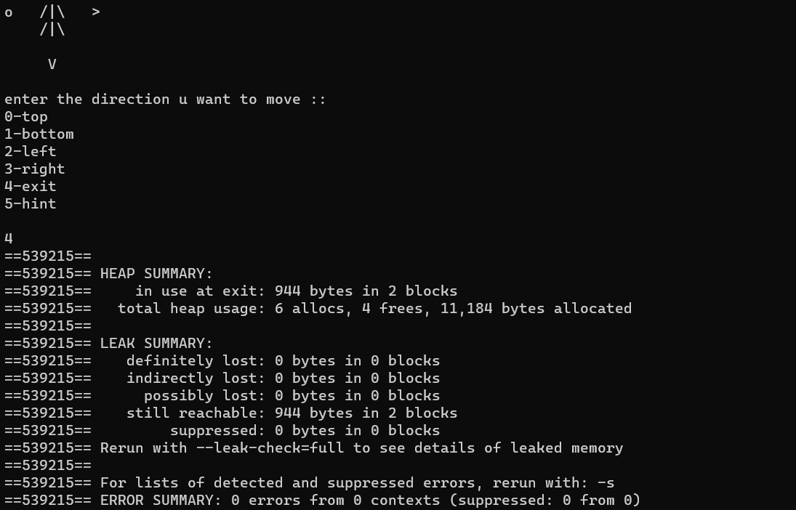
Non Functional Requirements
Valgrind - Valgrind is a programming tool for memory debugging, memory leak detection, and profiling.

Slide 27
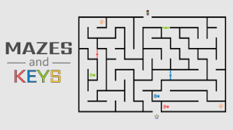
Application
These games emphasize long term planning, analytics, and skillful thinking in order to achieve victory. A player's decisions are important in determining the outcome of the game, and players are required to weigh the potential impact of multiple decisions in order to win.
Logic puzzles are an integral part of entertainment which find place in various newspapers, magazines and even mobile applications or web pages. These types of tasks are to find a solution or answer by using reasoning based on knowledge or intuition.
Image credits to safekidgames.com

Slide 28
Challenges Faced
Code Integration among teammates.
File Handling.
Continuous code modification
Lots of documentations.
Validation of all the easy and hard mazes for all possible cases.
Using the numbers to differentiate file for compiler to read.

Slide 29
Conclusion
We were successful in implementing the project within the time specified keeping the requirements in minds.
Tha game was created using 2D Arrays concept, with a mixture of conditional statements, file handling utilities and error detection code.

